Slide 1
L4/5 Group 1
Alice Baker
Dragos Liche
Kenneth Pirkle
Jordan Carman

Slide 2
The Brief
2D Game with a ‘simple tap’ mechanic
Multiplayer – on a single mobile device
Symmetric gameplay
Notes:
Alice

Slide 3
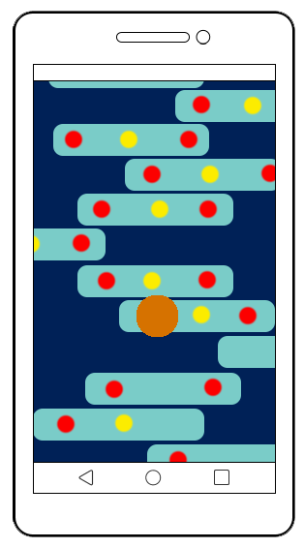
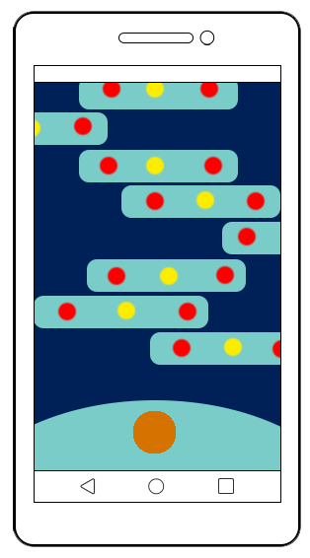

Concept
Below:
Starting position
Players take turns to tap on the screen
Character jumps across moving platforms
Collect points – higher value closer to the edges
Camera moves independently – character must keep up
Above:
During gameplay
Notes:
Alice

Slide 4
Who is the game for?
Target audience – Male & Female, all ages
‘People Fun’ – players can compete or cooperate
‘Hard Fun’ – challenging gameplay
Notes:
Ken

Slide 5

Core game loop
Notes:
Jordan

Slide 6
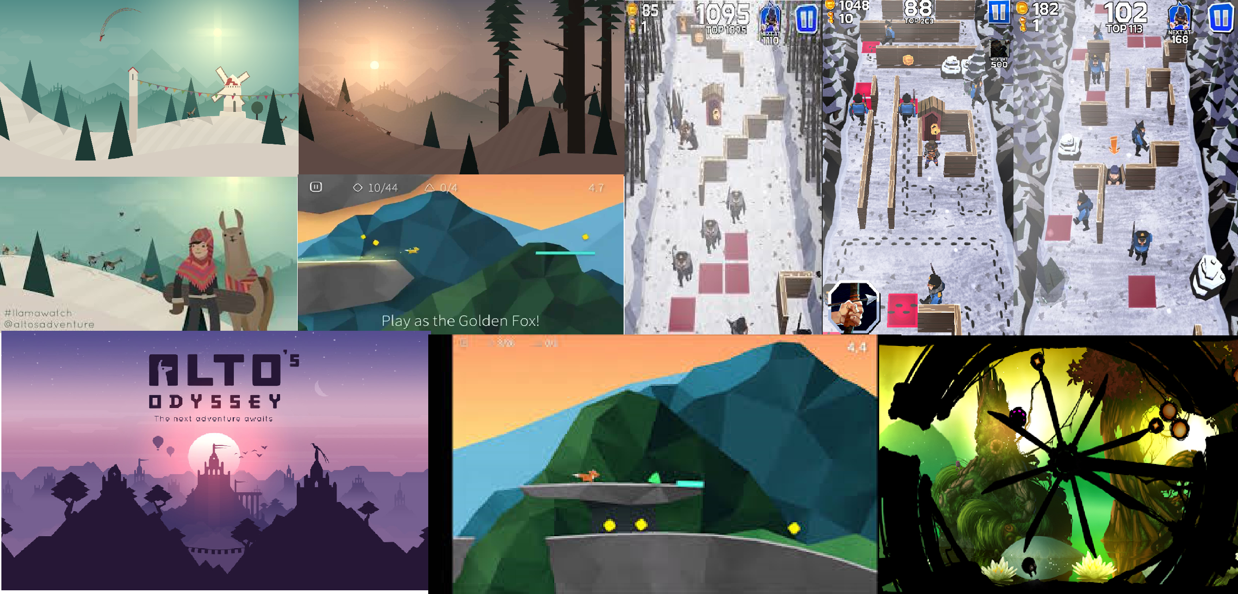
Art Style
Notes:
Dragos

Slide 7
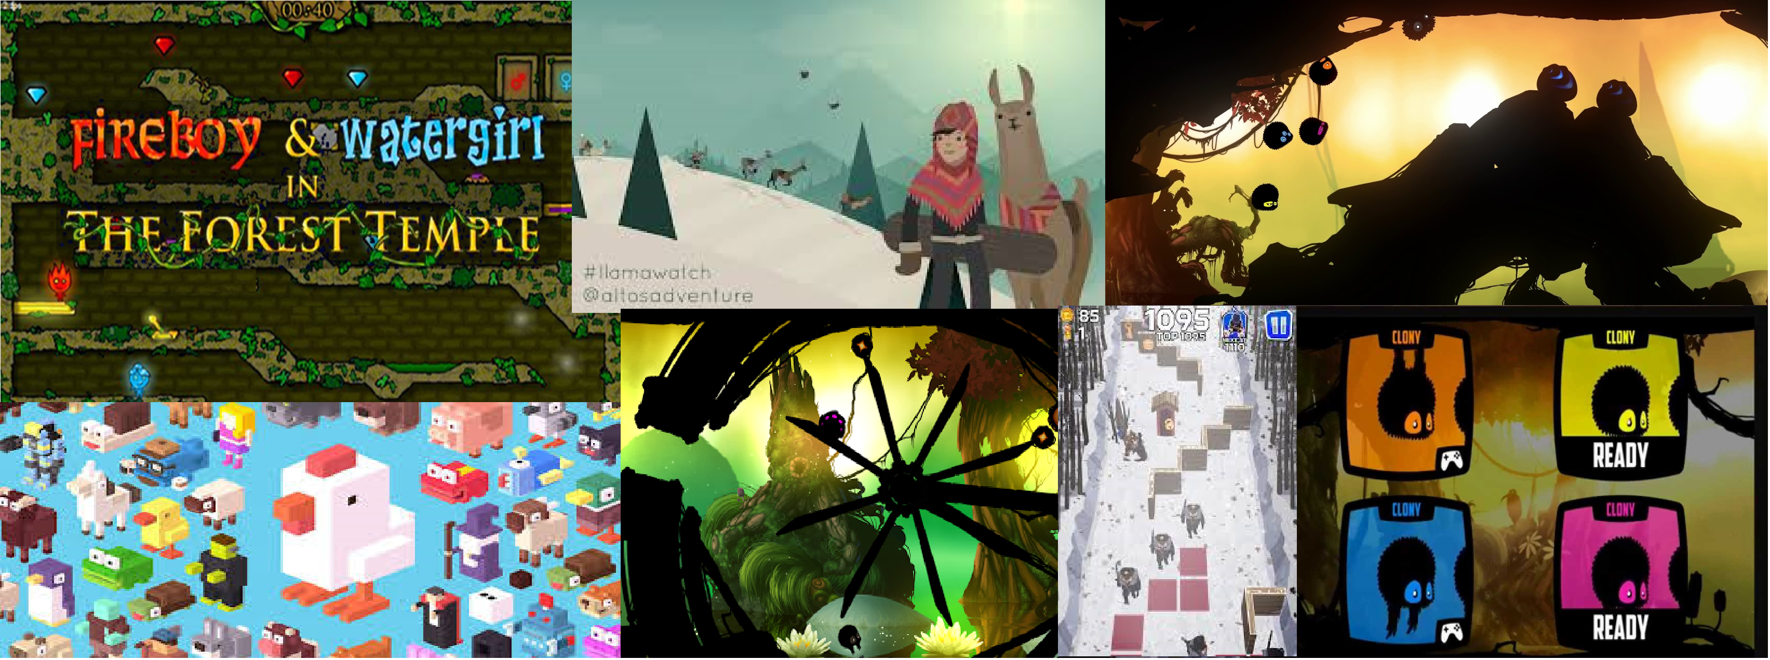
Characters & Mechanics
Notes:
Dragos

Slide 8
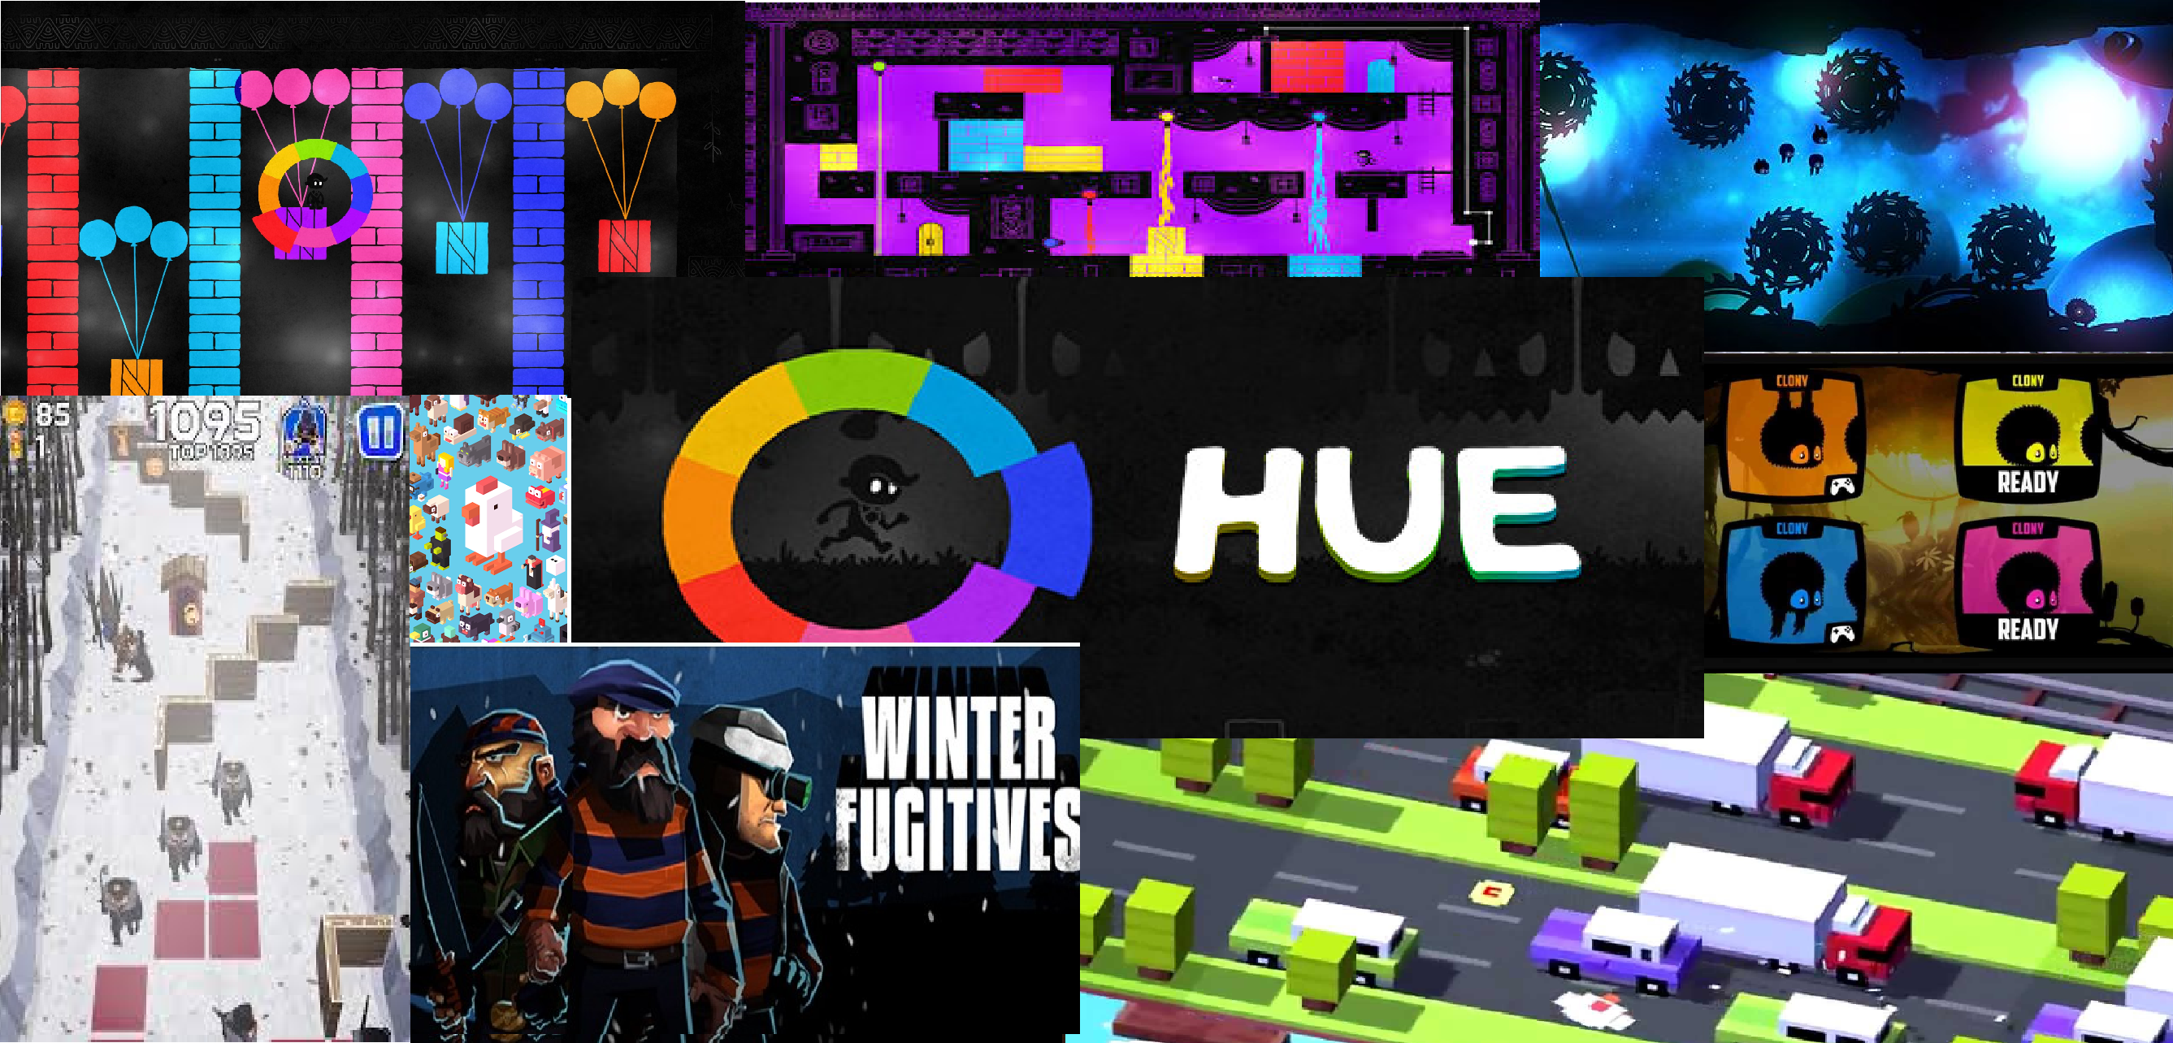
Mechanics
Notes:
Dragos

Slide 9
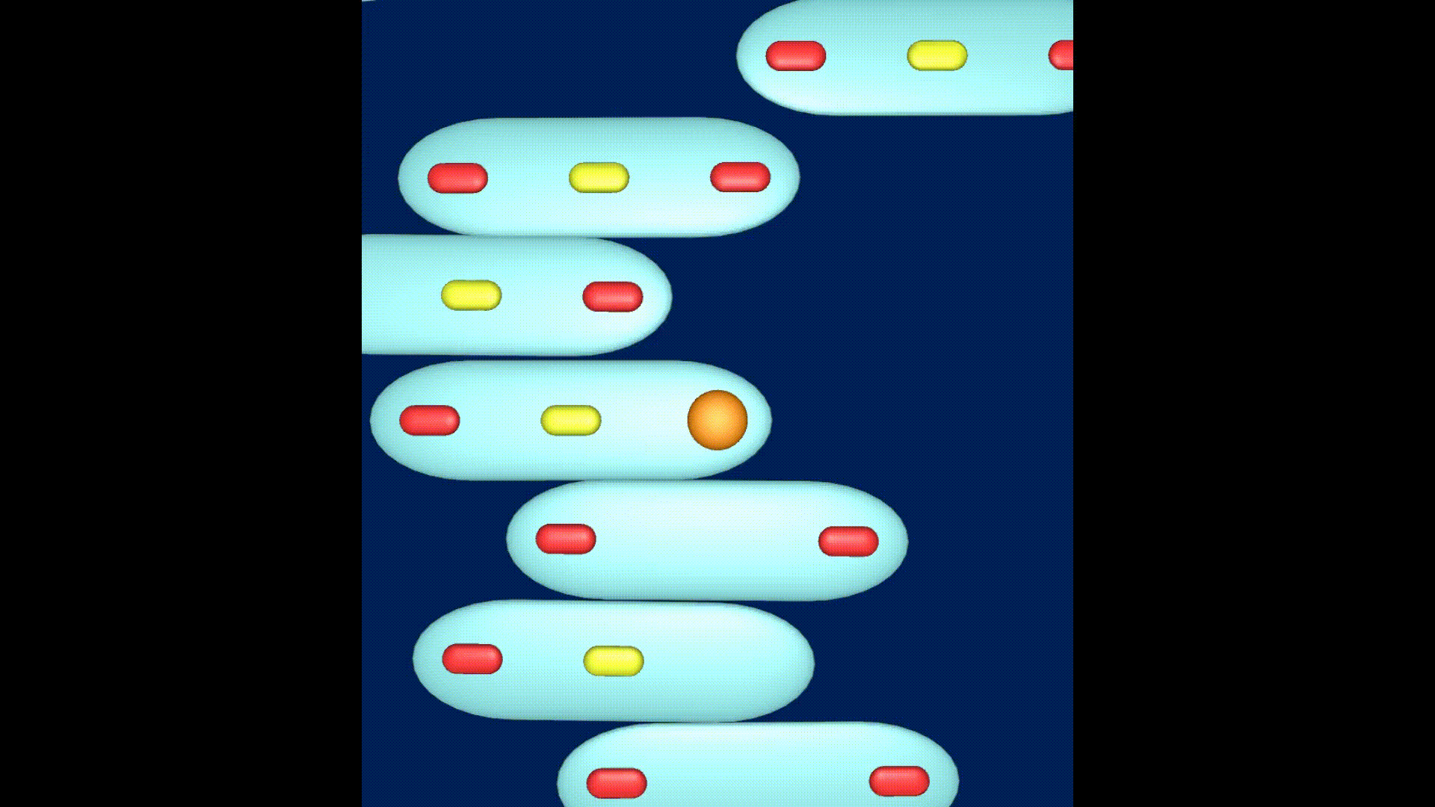
Prototype
Notes:
Ken and Jordan

Slide 10
Thanks for watching!
Any questions?
Notes:
Alice

